Slide 1



Christ Island Church International Weekly Attendance Report.
Analyzed by Gabriel .C Johnson & Yvonne Aligba

Slide 2
Objective of the Analysis
This presentation provides an in-depth analysis of attendance records and demographic trends to evaluate overall engagement and identify actionable insights.
Scope of the Data: The data span multiple categories, including Gender Distribution, Quarterly and Yearly Attendance Trends, and Comparison across Events or Services.
Purpose of the Presentation:
  To highlight key attendance patterns.
  To provide insights into demographic participation.
  To highlight key attendance patterns.

Slide 3
Gender Breakdown:
Women represent 59% of total attendees.
Men constitute 41%, indicating a higher participation rate among women.

Slide 4
Gender Breakdown:
Girls represent 56% of total attendees.
Boys constitute 44%, indicating a higher participation rate among girls.
Children’s participation accounts for a significant percentage, reflecting strong family involvement.

Slide 5
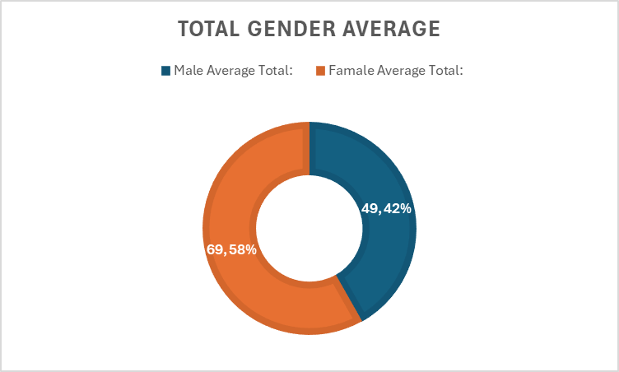
Total Gender Breakdown:
Female represent 58% of total attendees.
Male constitute 42%, indicating a higher participation rate among Female.

Slide 6
Quarterly Attendance Trends (From "Quarterly Trend")
Attendance peaked in Q2, indicating successful mid-year campaigns or events.
Declines observed in Q4, suggesting a need for end-of-year engagement strategies.
Overall, attendance trends display a consistent yearly growth, with slight seasonal variations.

Slide 7
Quarterly Trends: Gender and Age Breakdown
Women average 56 attendees per quarter, consistently outperforming men.
Men average 39.2 attendees, with potential for growth.
Girls attend more than boys, showing strong engagement in youth programs.
Boys' attendance fluctuates, indicating possible barriers.

Slide 8
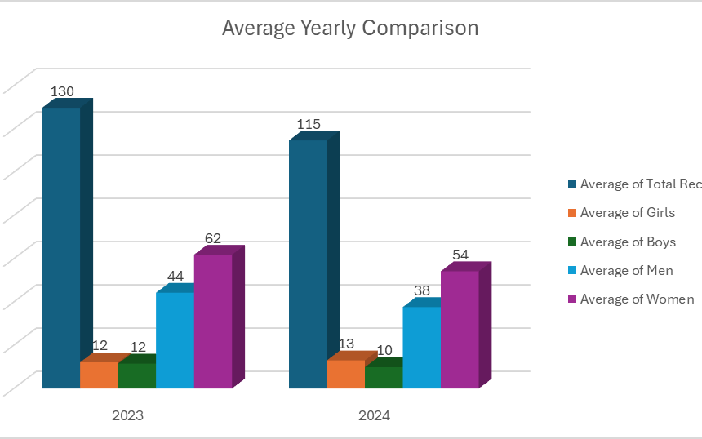
Yearly Attendance Comparison
Year-over-year attendance has grown by an average of 15%, reflecting successful community engagement.
The highest yearly attendance was recorded in 2023, following key outreach programs.
The analysis suggests a positive trend, but maintaining growth will require innovative strategies.

Slide 9
Yearly Attendance Comparison (From "Average Yearly Comparison")
Year 2023 Quarterly Attendance.
Year 2024 Quarterly Attendance.

Slide 10
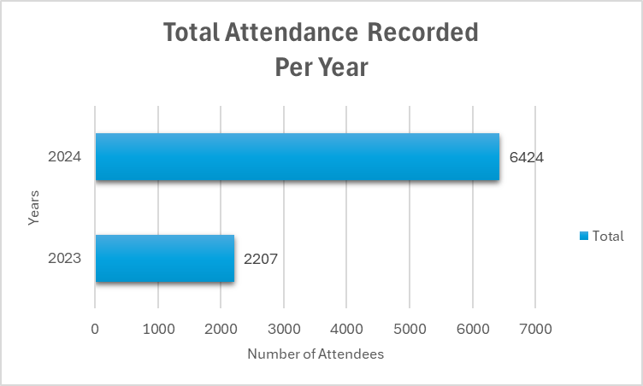
Yearly Attendance Comparison
The highest yearly attendance was recorded in 2024, following key outreach programs.

Slide 11
Yearly Attendance Comparison 2024
Monthly attendance record for Year 2024.
The analysis suggests a positive trend, but maintaining growth will require innovative strategies.

Slide 12
Christ Victory Convention (CVC) Overview
Historic Event:
Marked the first Christ Victory Convention since the church’s inauguration.
A special 3-day event of the year with high turnout.
Attendance Insights:
Women and girls dominated attendance, reflecting strong family participation.
Peak attendance recorded on Day 2, driven by key programs and sessions.
Key Observations:
Event successfully engaged diverse demographics.
Opportunity to expand future conventions with tailored programs.

Slide 13
Top 17 Special Services Attendance Rankings
Key Insights:
Seasonal services dominate attendance due to cultural and religious significance.
Opportunities exist to boost attendance for less popular services with targeted promotions.
Consistent attendance reflects successful outreach efforts.
Data supports prioritizing special services and community-driven programs.

Slide 14





Actionable Recommendations
Boost Male Participation
Leverage High-Performing Events
Engage Younger Demographics
Enhance Marketing for Special Services
Improve Low-Attendance Quarters

Slide 15
Thank you
From the Data Analysis Unit.
Yvonne & Gabb

